Slide 1
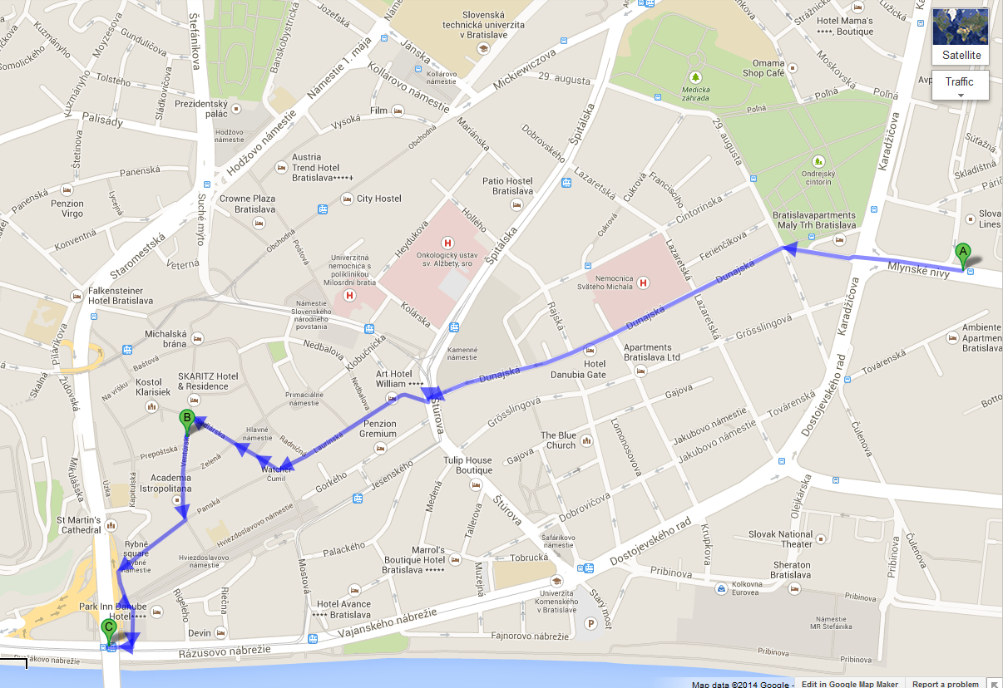
Carpathian Convention Working Group on Sustainable Tourism meeting, 12 -14 May 2014, Bratislava - MAP
A: Slovaklines bus stop Mlynské Nivy
Coach Station
B: the venue Univerzitna kniznica,
Venturska 11
C: Blaguss stop, Novy most
(Most SNP – under the bridge)

